Slide 1

Lecture 10: Textual Data and Github
Intro to Data Science for Public Policy
Jeff Chen

Slide 2
Roadmap
Text Data
Anatomy of a webpage
Codealong – Scrape a web page
Codealong – Sentiment Analysis
Codealong – Topic Models
Github
Intro to Data Science for Public Policy

Slide 3
[]

Slide 4
[]

Slide 5
Given billions of queries, how are these trending indexes produced?

Slide 6
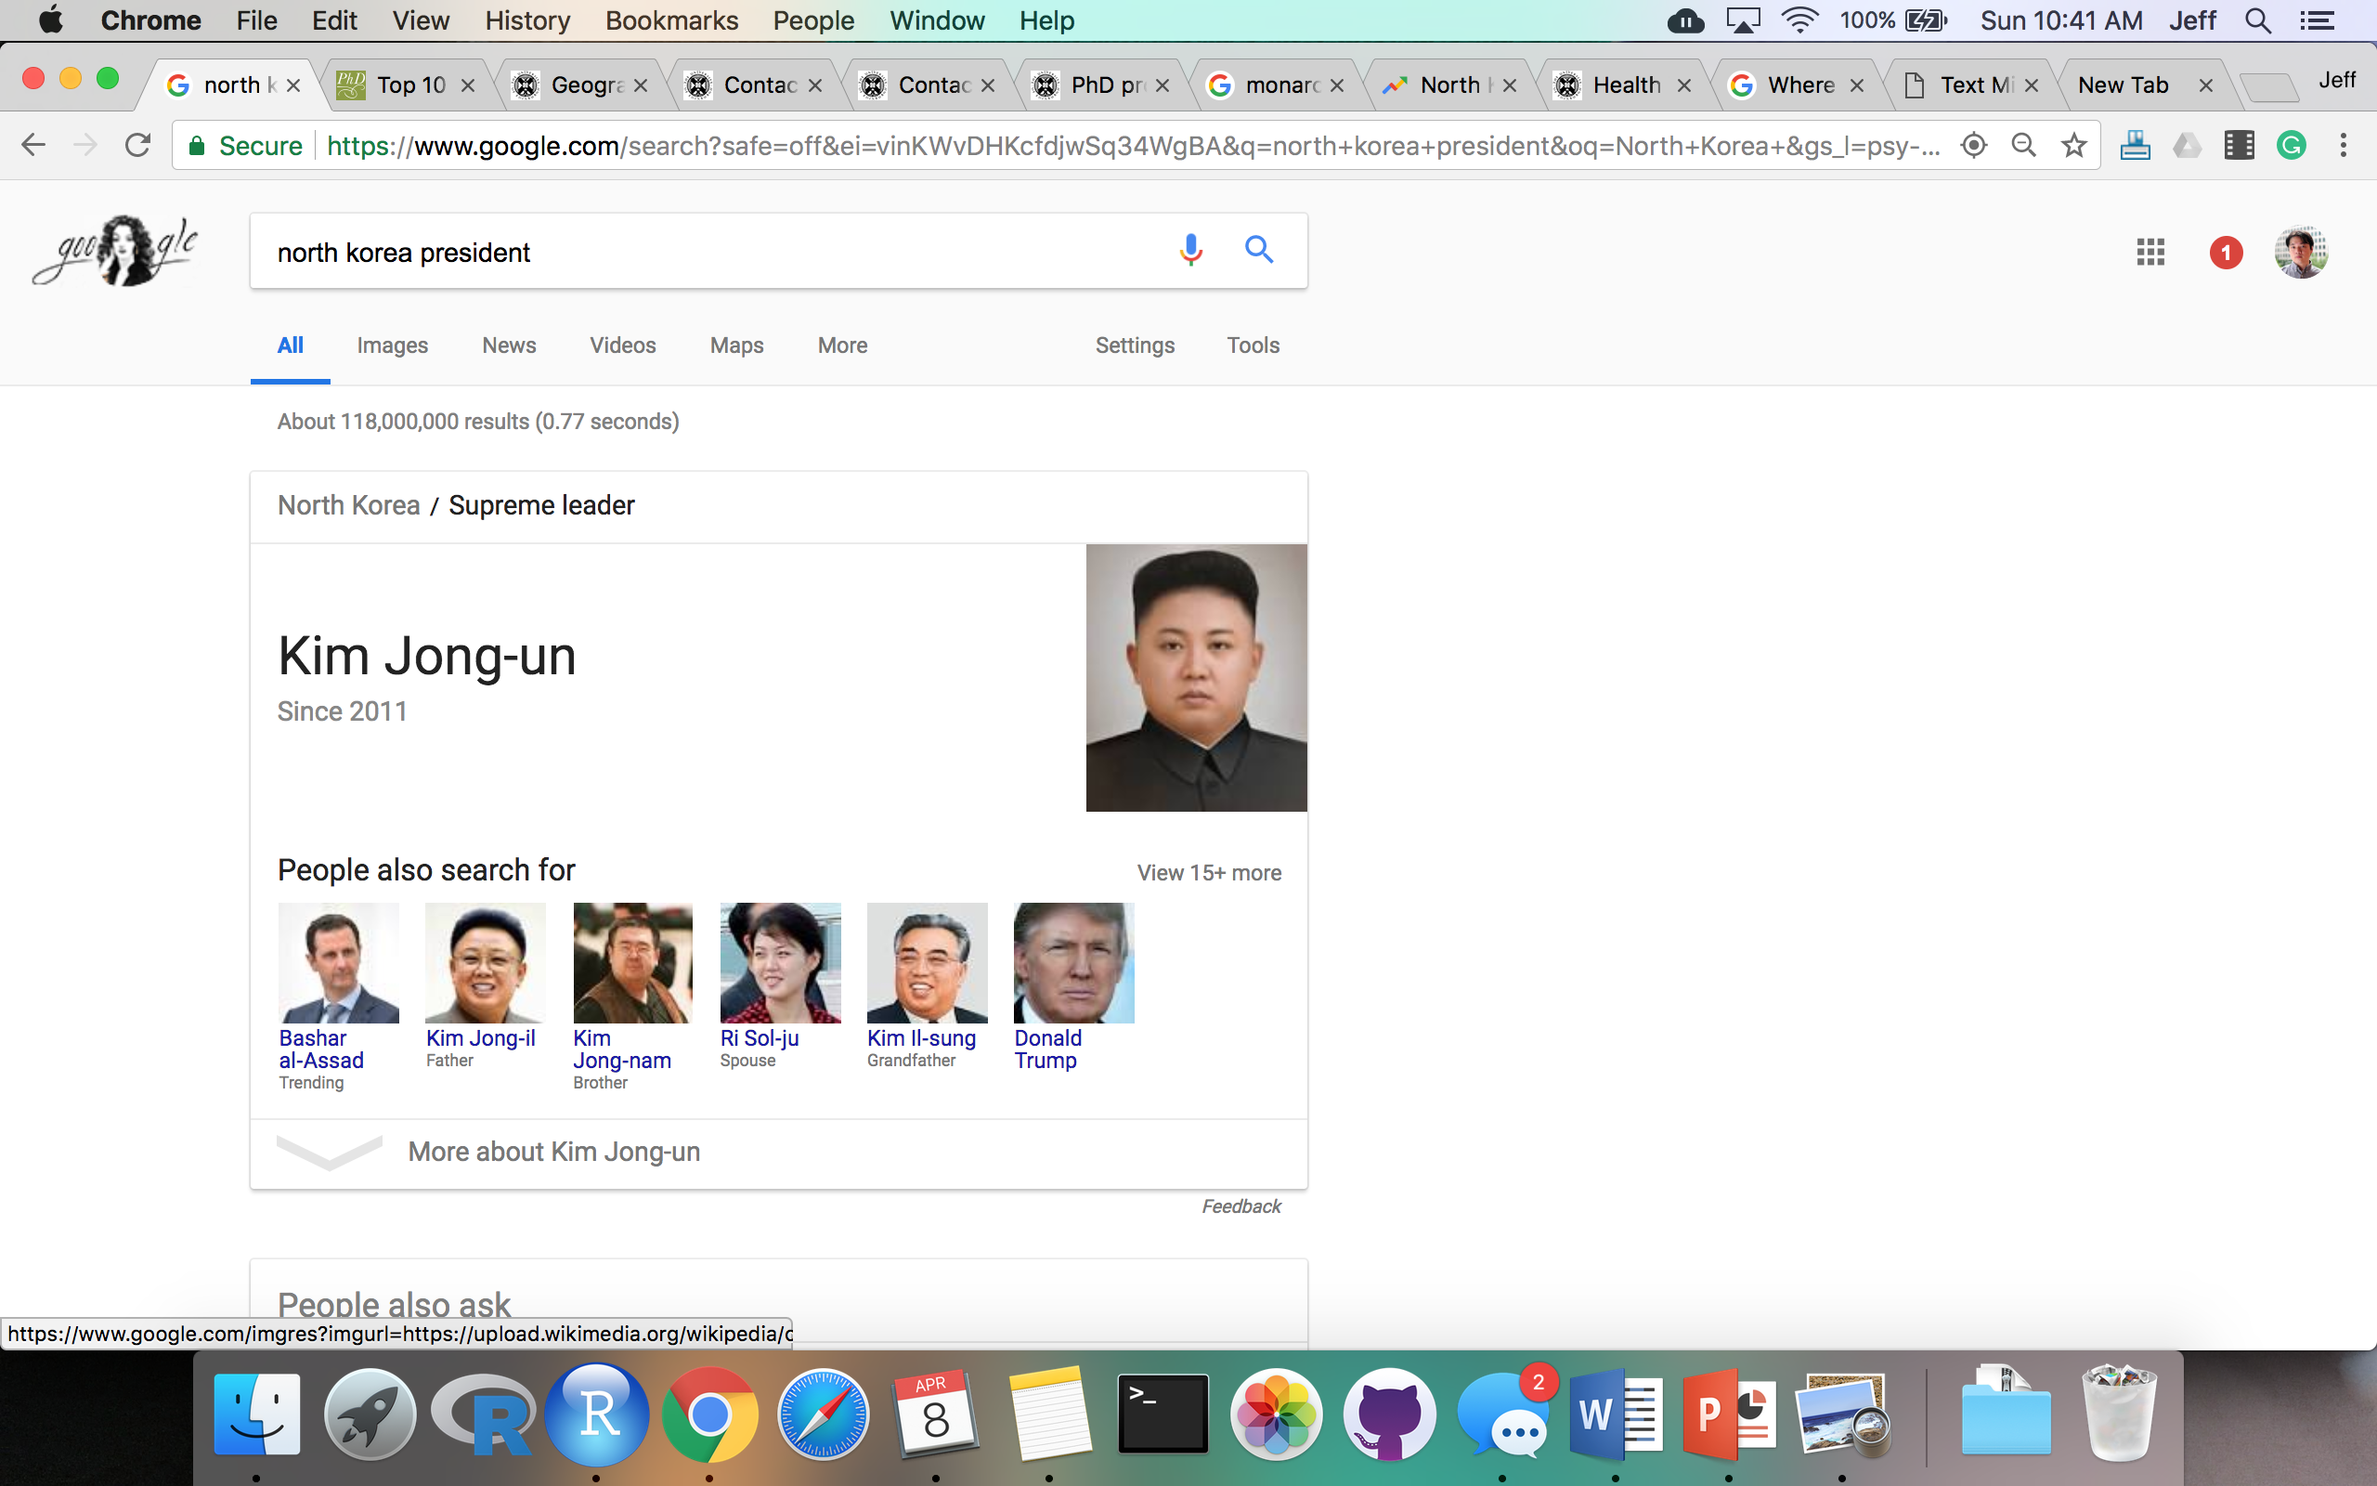
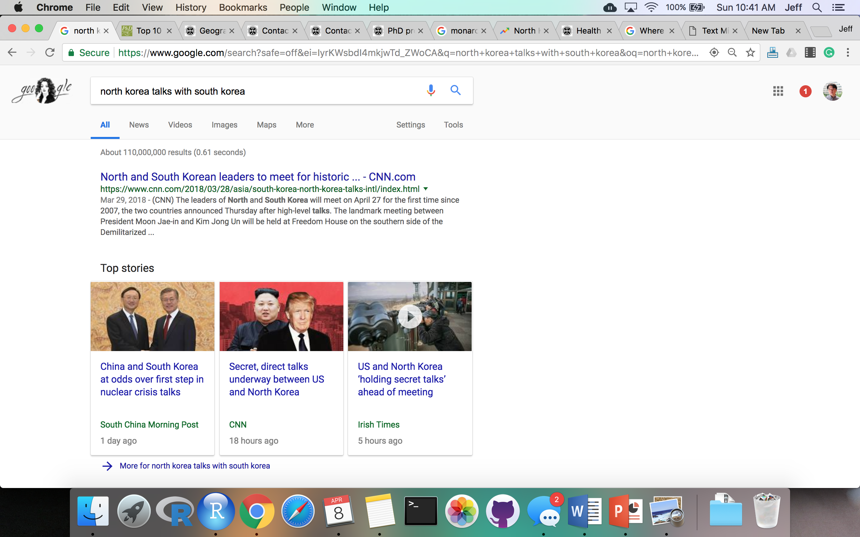
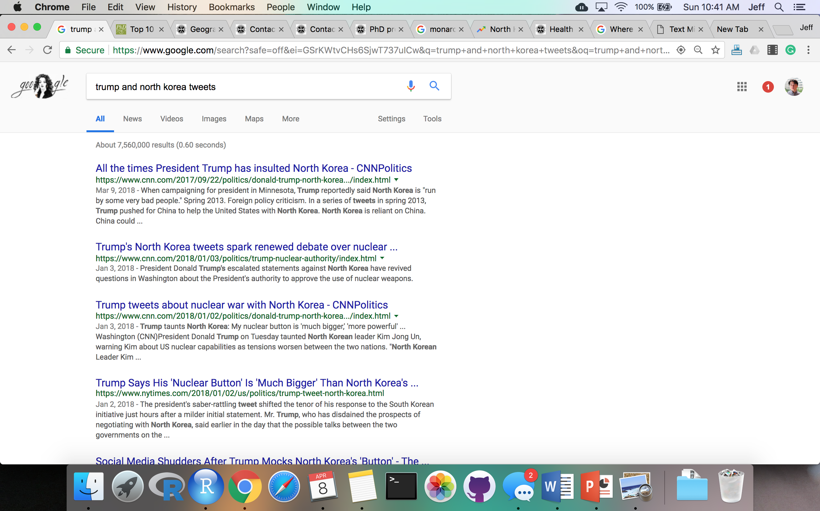
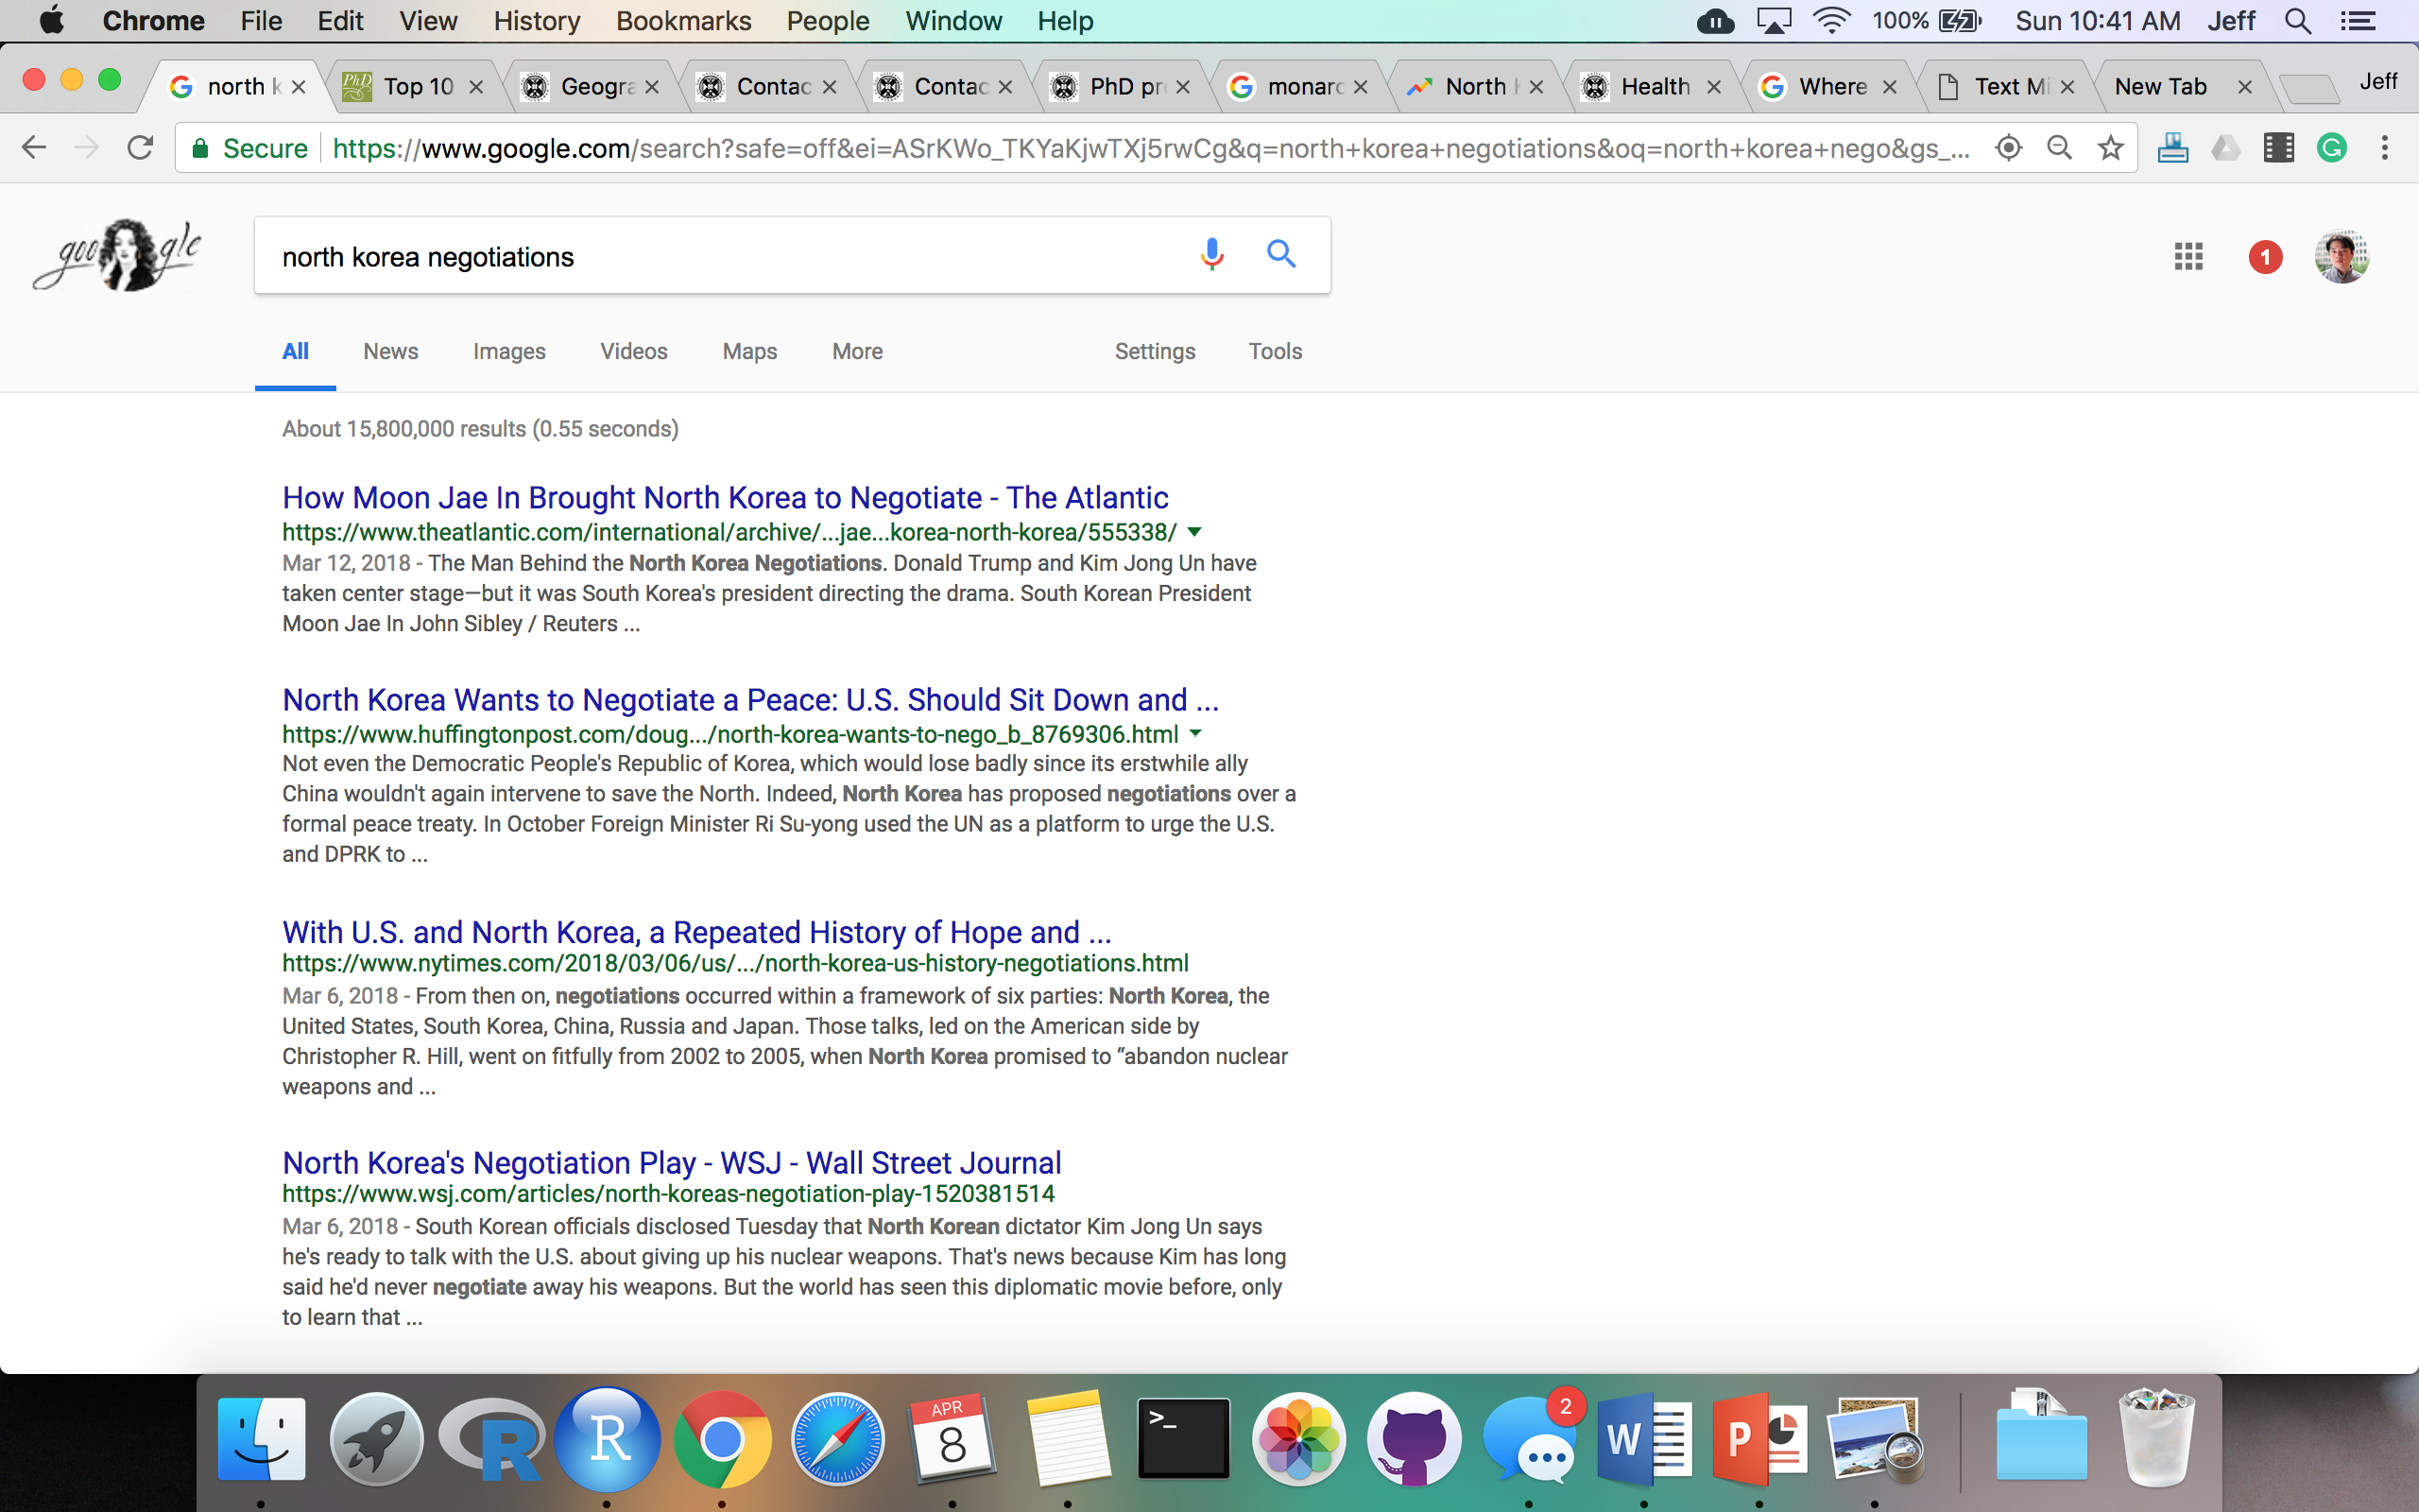
.
.
.
Given search queries, how does one extract the topic of “North Korea” (and any topic for that matter)?

Slide 7
Parse keywords and keyphrases in the form of ‘n-grams’!
Unigrams
north
Korea
Talks
With
South
Korea
Bi-grams
North korea
Korea talks
Talks with
With south
South korea
Tri-grams
North korea talks
Korea talks with
Talks with south
With south korea

Slide 8
Converting text into n-grams is called ‘tokenization’.
Each term is referred to as a ‘token’.
Unigrams
north
Korea
Talks
With
South
Korea
Bi-grams
North korea
Korea talks
Talks with
With south
South korea
Tri-grams
North korea talks
Korea talks with
Talks with south
With south korea

Slide 9
Each token is then counted.
Unigrams
north - 1
Korea - 2
Talks - 1
With - 1
South - 1
Korea
Bi-grams
North korea - 1
Korea talks - 1
Talks with - 1
With south - 1
South korea - 1
Tri-grams
North korea talks - 1
Korea talks with - 1
Talks with south - 1
With south korea - 1

Slide 10
What can one do with tokens?
Search
Engine
TF-IDF
and Indexing
Recommendations
Engine
Tokens
Topic Modeling
Sentiment
Analysis

Slide 11
Text data fit into a broader workflow.
Search
Engine
Websites
(HTML)
TF-IDF
and Indexing
Rec
Engine
Text
Data
ETL
Process
Topic Modeling
Text
docs
Sentiment
Analysis

Slide 12
Roadmap
Text Data
Anatomy of a webpage
Codealong – Scrape a web page
Codealong – Sentiment Analysis
Codealong – Topic Models
Github
Intro to Data Science for Public Policy

Slide 13
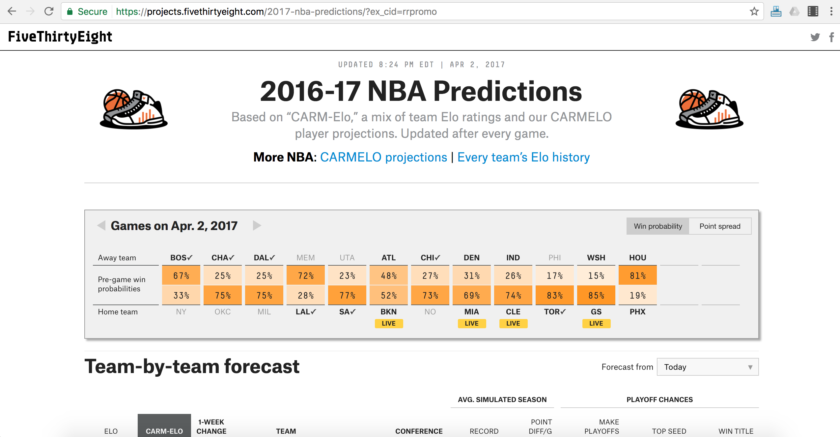
What we see in the browser
[]
HTML/CSS

Slide 14
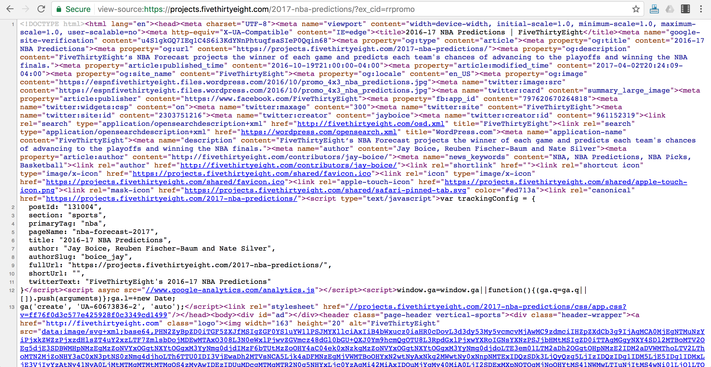
What the browser sees
[]
HTML/CSS

Slide 15
What the browser sees
[]
Most websites use
Hypertext Markup Language (HTML)
to codify the structure and contents of a web page.
HTML/CSS

Slide 16
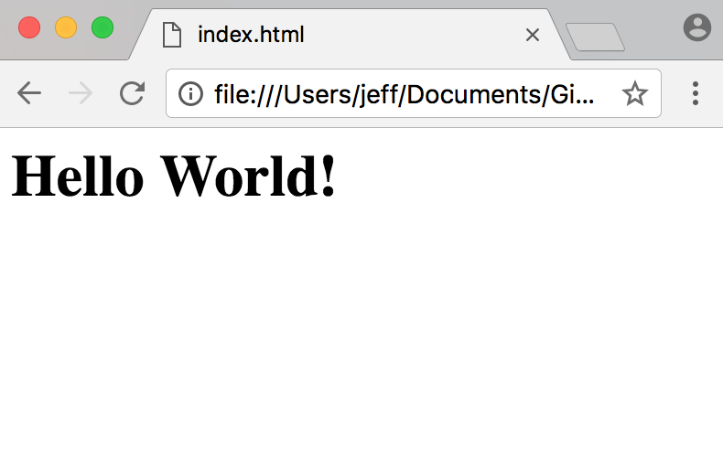
HTML
<html>
<body>
<h1> Hello World!</h1>
</body>
</html>
HTML/CSS

Slide 17
HTML
text in <> are “tags”
Each tag represents a type of content
<html> = root element of structure
<body> = contains visible content
<h1> = large heading
<html>
<body>
<h1> Hello World!</h1>
</body>
</html>
HTML/CSS

Slide 18
HTML
<h1> Hello World!</h1>
<tags> tend to come in pairs to indicate where the element starts and ends.
HTML/CSS

Slide 19
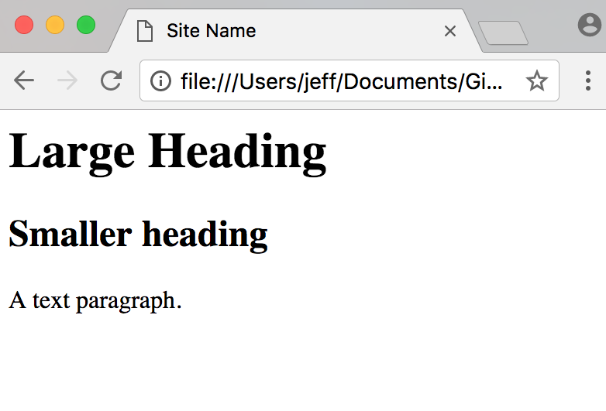
HTML
<!DOCTYPE html>
</html>
<head>
<style> </style>
<title> Site Name </title>
</head>
<body>
<h1> Large heading </h1>
<h2> Smaller heading </h2>
<p> A text paragraph. </p>
</body>
HTML/CSS

Slide 20
HTML: Tags Galore
Basics
<body>
<html>
<title>
Sections
<div>
<section>
Images
<img>
<picture>
<canvas>
Tables
<table>
<td>
<th>
<tr>
There are many types of tags that can be creatively strung together to structure of webpage.
Text
<h1>
<h2>
<h3>
<h4>
<h5>
<p>
Breaks
<hr>
<br>
Frames
<iframe>
Styles
<style>
<head>
Lists
<ul>
<ol>
<li>
Links
<a>
<nav>
Programming
<script>
HTML/CSS

Slide 21
HTML
But how about the styles?
(who wants a website from the 90’s?)
HTML/CSS

Slide 22
What the browser sees
[]
Most websites use
Cascading Style Sheets (CSS)
to format the HTML.
HTML/CSS

Slide 23
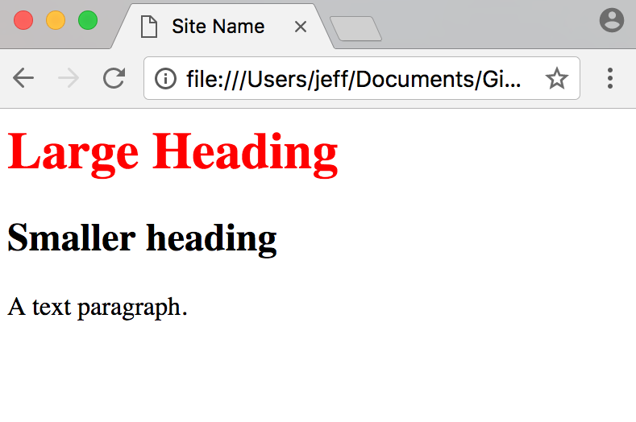
HTML + CSS
CSS can be included in the <style> tag to format all <h1> tags as red.
<!DOCTYPE html>
</html>
<head>
<style>
h1{
color: red;
}
</style>
<title> Site Name </title>
</head>
<body>
<h1> Large heading </h1>
<h2> Smaller heading </h2>
<p> A text paragraph. </p>
</body>
HTML/CSS

Slide 24
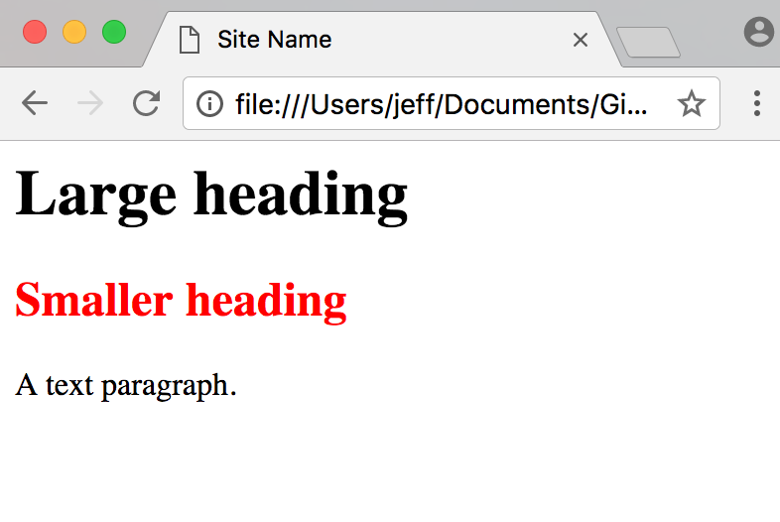
HTML + CSS
CSS can be used to define a ”class” of formats that can be applied anywhere the class is referenced.
<!DOCTYPE html>
</html>
<head>
<style>
.col1{
color: red;
}
</style>
<title> Site Name </title>
</head>
<body>
<h1 Large heading </h1>
<h2 class="col1"> Smaller </h2>
<p> A text paragraph. </p>
</body>
HTML/CSS

Slide 25
HTML + CSS
CSS can be called into the HTML file from a .css file
index.html
<!DOCTYPE html>
</html>
custom.css
<head>
<link rel="stylesheet" href='css/custom.css' rel='stylesheet' type='text/css'>
<title> Site Name </title>
</head>
.col1{
color: red;
}
<body>
<h1 Large heading </h1>
<h2 class="col1"> Smaller </h2>
<p> A text paragraph. </p>
</body>
HTML/CSS

Slide 26
A short aside
[]
Most websites use
JavaScript (JS)
to add interactivity and data handling capabilities.
HTML/CSS

Slide 27




There are many libraries built on JavaScript (JS) including:
A short aside
(Not covered in this course)
HTML/CSS

Slide 28
HTML + CSS
CSS can be included in the <style> tag to format all <h1> tags as red.
<!DOCTYPE html>
</html>
<head>
<style>
h1{
color: red;
}
</style>
<title> Site Name </title>
</head>
<body>
<h1> Large heading </h1>
<h2> Smaller heading </h2>
<p> A text paragraph. </p>
</body>
HTML/CSS

Slide 29
Roadmap
Text Data
Anatomy of a webpage
Codealong – Scrape a web page
Codealong – Sentiment Analysis
Codealong – Topic Models
Github
Intro to Data Science for Public Policy

Slide 30
Roadmap
Text Data
Anatomy of a webpage
Codealong – Scrape a web page
Codealong – Sentiment Analysis
Codealong – Topic Models
Github
Intro to Data Science for Public Policy

Slide 31
Roadmap
Text Data
Anatomy of a webpage
Codealong – Scrape a web page
Codealong – Sentiment Analysis
Codealong – Topic Models
Github
Intro to Data Science for Public Policy

Slide 32
Roadmap
Text Data
Anatomy of a webpage
Codealong – Scrape a web page
Codealong – Sentiment Analysis
Codealong – Topic Models
Github
Intro to Data Science for Public Policy

Slide 33
What is Github?
A place to store, manage and collaborate on versions of a programming project.

Slide 34
Key concepts
Github workflow
Web GUI
Desktop GUI
Command-line git

Slide 35
Key concepts (today)
Github workflow
Web GUI
Desktop GUI
Command-line git

